Slide 1
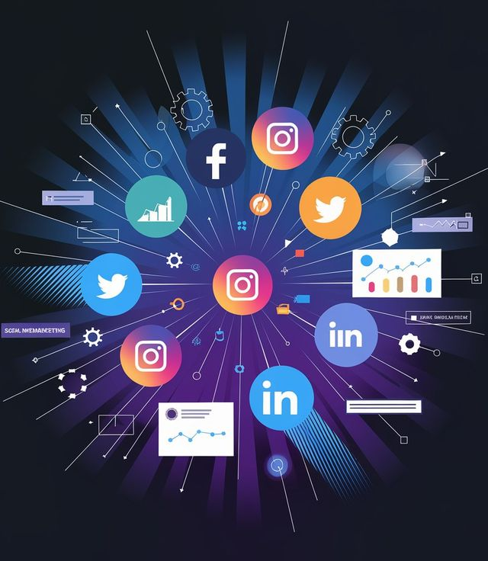
Social Media Project
Submitted By:
Isha Sarkar

Slide 2
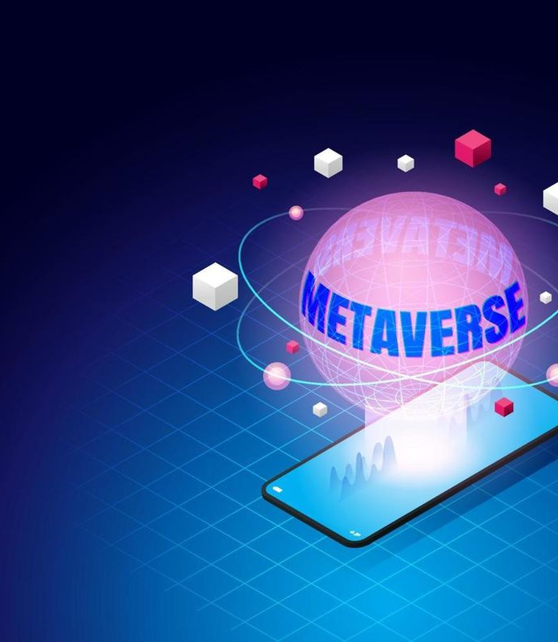
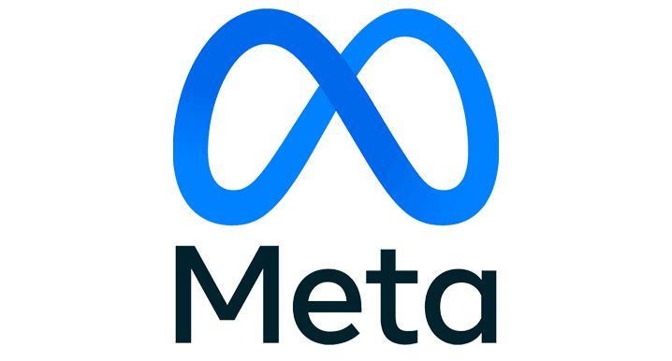
Meta Platforms, Inc. is a global technology company known for connecting people through its social media platforms — including Facebook, Instagram, and WhatsApp. Meta is focused on building the next generation of social experiences, including immersive digital spaces like the metaverse. With billions of users worldwide, Meta uses data-driven insights to improve user engagement, personalization, and advertising strategies.

Slide 3
Agenda
Introduction & Problem Statement
Data Overview & Schema
Data Cleaning & Preparation
Key Insights & Visualizations
Influencer Identification & Inactive Users
Marketing Strategy Recommendations
Conclusion
References

Slide 4

You are hired as a data analyst at Meta and asked to collaborate with Marketing team. Marketing teams wants to leverage Instagram's user data to develop targeted marketing strategies that will increase user engagement, retention, and acquisition. Provide insights and recommendations to address the following objectives
Problem statement

Slide 5
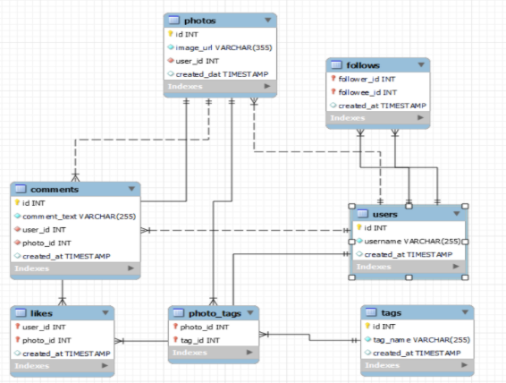
Database schema

Slide 6
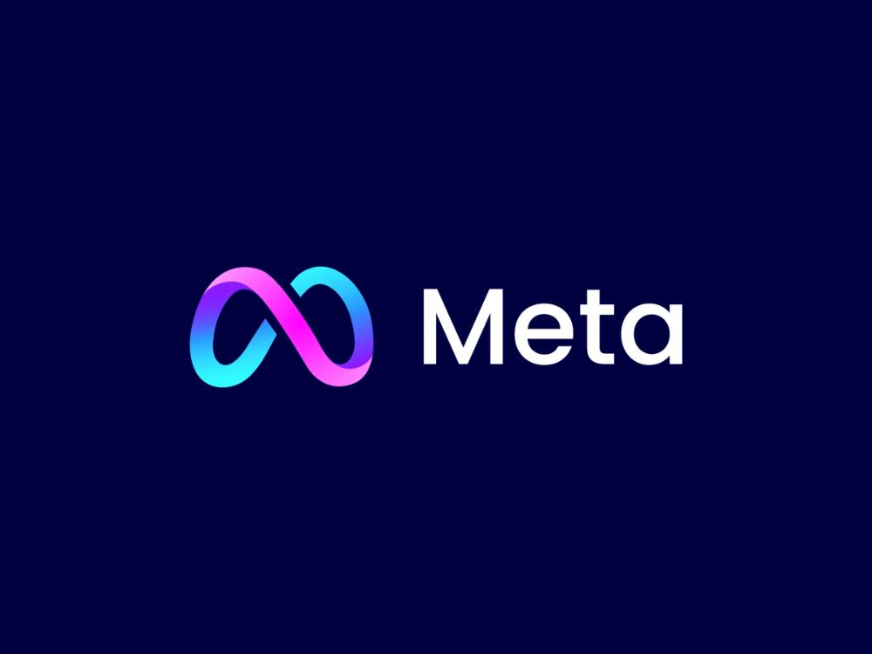
Data description
comments_id : unique identifier for each comment
comment_text : text content of a given comment
user_id : unique identifier for each user
photo_id : unique identifier for each photo
created_at : date of interaction in the form like, photos, tags
follower_id : user_id of the follower for a certain user
followee_id : user_id of followee for a certain user
tag_id : unique identifier for each tag
image_url : link to the image posted on the platform
username : username chosen by the user

Slide 7
Data Cleaning & Preparation
No duplicate ids in users, photos, tags
Mapping tables (likes, follows) had unique rows
Null values filtered using IS NOT NULL
Foreign keys validated with joins
Manual spot checks ensured accuracy
Final dataset ready for analysis

Slide 8
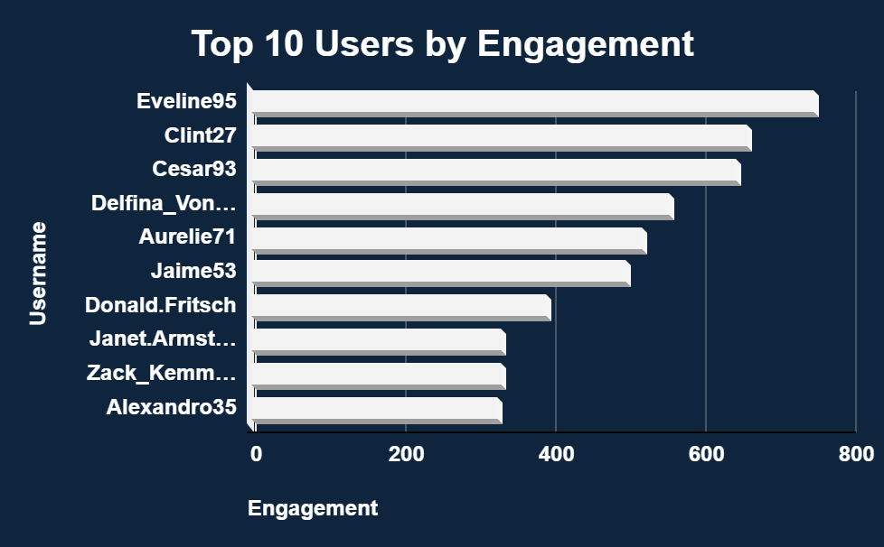
Users like Eveline95 and Clint27 consistently receive the highest interactions. They’re strong candidates for personalized campaigns and community ambassador roles.
Top Engaged Users

Slide 9
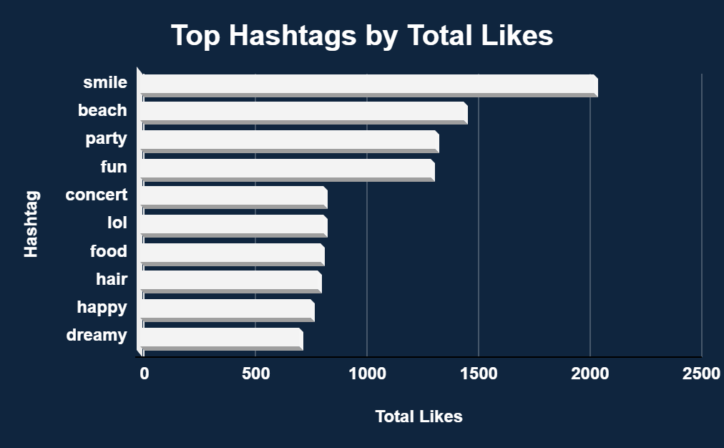
Engagement by Hashtag
Tags like #smile, #beach, and #party have the highest engagement, indicating strong user interest and visual appeal. These tags represent ideal themes for ad targeting, influencer collaborations, or content boosting to maximize relevance, emotional connection, and reach in personalized marketing campaigns.

Slide 10
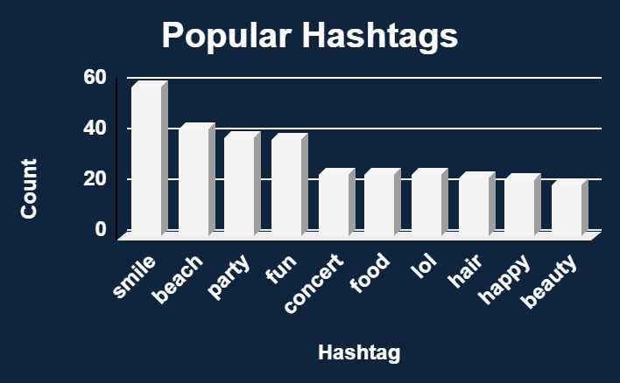
Popular Hashtags
#smile is the most frequently used hashtag (59 times), indicating a strong emotional or visual appeal that resonates with users.
Hashtags like #beach, #party, and #fun reflect lifestyle and leisure-oriented content — suggesting a user preference for personal moments and events.
Tags like #concert, #food, and #lol show interest in entertainment and everyday experiences, offering an opportunity to amplify casual or trending topics.

Slide 11
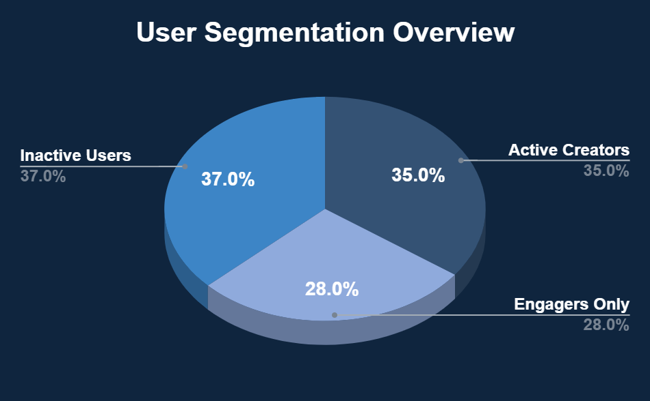
User Segmentation Insights
Only ~35% of users actively create content. A large portion (~37%) are inactive, while others engage without posting. Marketing campaigns should target re-engaging inactive users and converting engagers into creators.

Slide 12
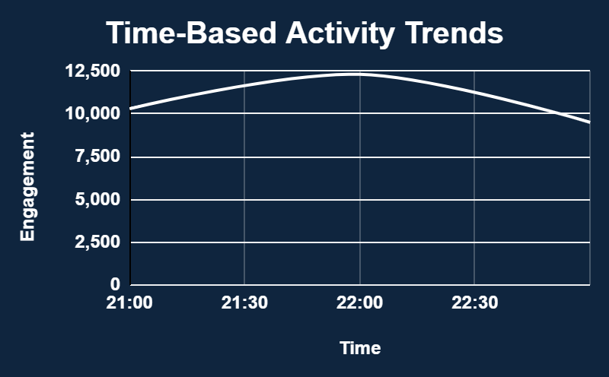

Time-Based Activity Trends
Engagement peaks around 9:15 PM.
Most likes and comments occur in the evening, especially around 9 PM.
Marketing campaigns can be timed for this window.

Slide 13
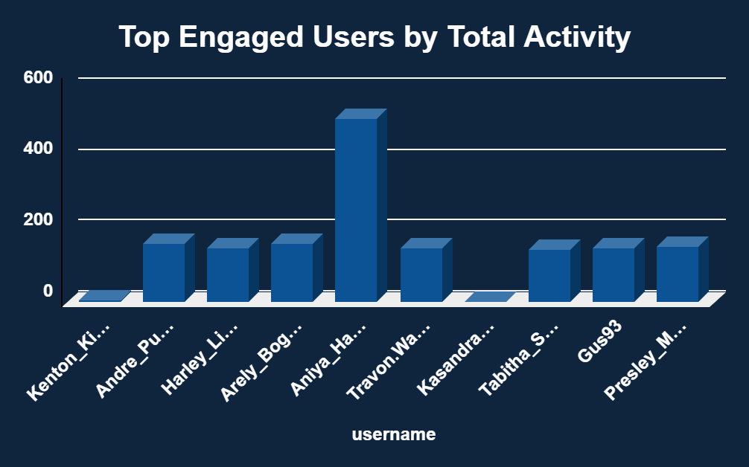
Top Engaged Users by Total Activity
Measures overall user engagement by combining posts, likes, and comments.
Aniya Hackett and Travon Waters are among the most engaged users on the platform.
Identifies potential brand advocates or power users.
Useful for influencer marketing, loyalty programs, or early feature access.

Slide 14
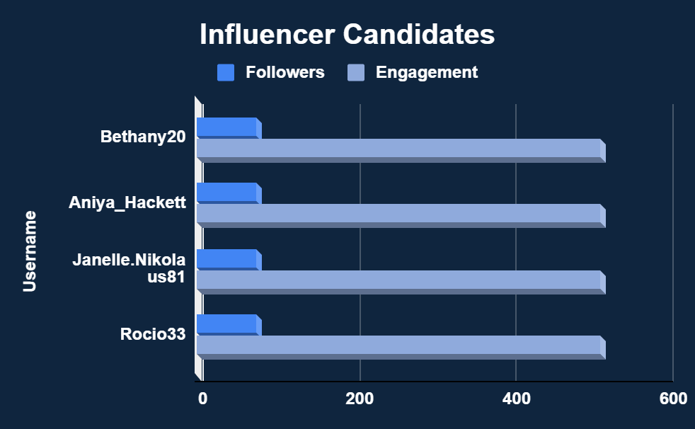
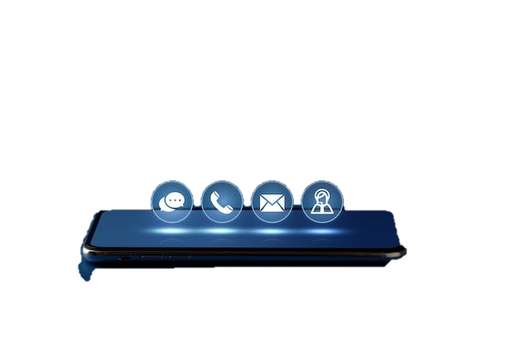
Influencer Candidates
These users show both reach and interaction. They’re ideal for brand ambassador programs.
This users have similar follower counts and with consistently high engagement, indicating strong, loyal audience interaction.

Slide 15
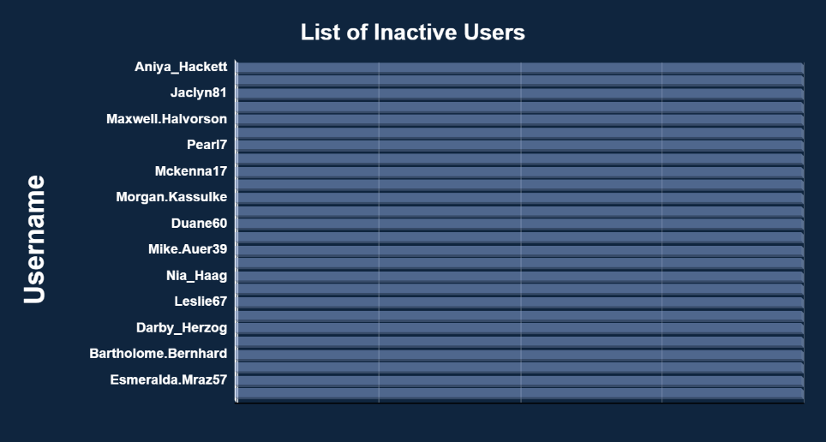
Inactive users
These are users who have never posted, liked, or commented on any content. They represent a silent segment of the user base with zero engagement, offering a key opportunity for reactivation campaigns.

Slide 16
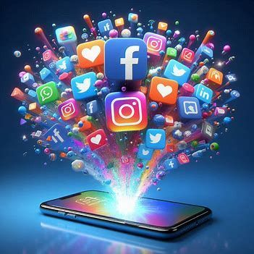
SQL played a vital role in extracting, analyzing, and interpreting Instagram’s user interaction data.
We identified the top-performing users based on likes and comments — valuable for loyalty or influencer marketing programs.
Hashtags like #smile, #beach, and #dreamy proved to be highly effective in driving engagement.
Peak activity times were uncovered around 9:15 PM, offering a key window for content posting and ad targeting.
Around one-third of users are inactive, presenting an opportunity for reactivation strategies.
Key Learnings from the Project

Slide 17
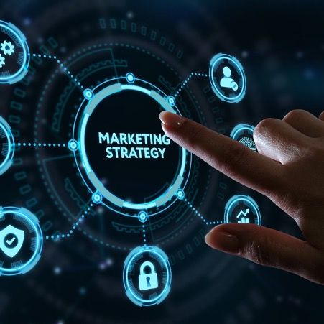
Marketing Strategy
Based on our analysis, we can now tailor Instagram’s marketing strategy to retain existing users, attract new ones, and increase platform engagement. For retention, we focus on loyal users and reactivating dormant accounts. For acquisition, we lean into viral content and hashtag trends. And for engagement, we use time- and interest-based targeting to deliver personalized experiences.

Slide 18
Conclusion
SQL helped unlock actionable insights from raw Instagram data.
We identified high-engagement users, viral hashtags, and peak activity periods.
Clear user segments emerged: active creators, passive engagers, and inactive users.
Insights from hashtags, content, and time-based trends support targeted marketing.
Engagement patterns guided influencer identification and personalization strategies.
The analysis bridges technical SQL skills with real marketing impact.

Slide 19
Recommendations
Identify & Reward High-Engagement Users: Recognize top users (likes + comments) with badges, exclusive features, or ambassador roles to improve retention and loyalty.
Re-engage Inactive Users: Target users who haven’t posted or liked anything with personalized content suggestions, first-post challenges, or reminder notifications.
Optimize Posting Times: Encourage creators and brands to post around 9:00–9:15 PM, the peak time for likes and comments, to maximize reach and interaction.
Leverage High-Performing Hashtags: Promote popular hashtags like #smile, #beach, and #dreamy to boost discoverability and virality of new posts.
Personalize Content Suggestions: Use user-tag interaction data to recommend content types, hashtags, or accounts users are more likely to engage with.
Partner with Influential Users: Collaborate with users who show both high engagement and follower count. These users can effectively represent the brand as micro-influencers.

Slide 20
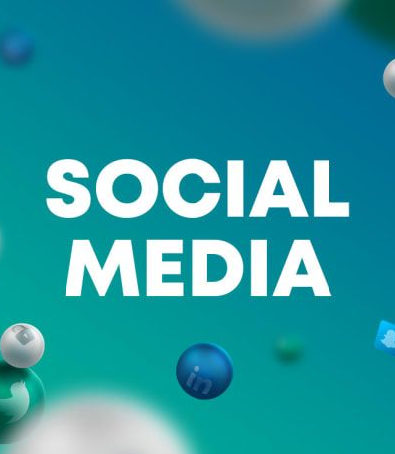
References
Meta for Developers – https://developers.facebook.com
Meta Business Suite – Insights & Ads – https://business.facebook.com
Instagram Help Center – https://help.instagram.com
Microsoft Excel – For charts and visualizations

Slide 21
Thank you
Isha Sarkar
ishasarkar003@gmail.com

